Slide 1

Sagar Institute of Science & Technology (SISTec)
CAPTCHA Recognition
Presented by
Guided by
Krishna Pal Verma (0187CS191073)
Md Aamir (0187CS191081)
Prashant Kumar Ary(0537CS191055)
Saurabh Kumar (0187CS191151)
Dr. Vasima Khan
Submitted for the partial fulfillment
of
Bachelor of Technology
in
Computer Science & Engineering
Department of COMPUTER SCIENCE & ENGINEERING
Dec - 2021

Slide 2
Content
Abstract
Introduction
Objectives
Software Requirements Specification
Algorithm
Tools and technologies
Screen shot
Conclusion
Future work
Captcha Recognition
Dec - 2021
2

Slide 3
1. Abstract
The Term CAPTCHA is an acronym for completely test to tell automated public turing computers The and human apart. CAPTCHA is a human-centred test to distinguish a human operator from bots, attacking programs, or other computerised agents that tries to imitate human intelligence. In this research, we investigate a way to crack visual CAPTCHA tests by an automated deep learning based solution. The goal of this research is to investigate the weaknesses and vulnerabilities of the CAPTCHA generator systems; hence, developing more robust CAPTCHAs, without taking the risks of manual try and fail efforts. We develop a Convolutional Neural Network called Deep-CAPTCHA to achieve this goal. The proposed platform is able to investigate both numerical and alphanumerical CAPTCHAs. To train and develop an efficient model, we have taken a dataset of 1070 CAPTCHAs to train our model from kaggle. In this project, we present our customised deep neural network model, we review the research gaps, the existing challenges. Our network's cracking accuracy leads to a high rate of 98.94% and 98.31% for the numerical and the alpha-numerical test datasets, respectively. That means more works is required to develop robust CAPTCHAs, to be non-crackable against automated artificial agents. As the outcome of this research, we identify some efficient techniques to improve the security of the CAPTCHAs, based on the performance analysis conducted on the Deep-CAPTCHA model
Captcha Recognition
Dec - 2021
3

Slide 4
2. Introduction
CAPTCHA stands for Completely Automated Public Turing test to tell Computers and
Humans Apart. CAPTCHA is a difficult acronym but is a Very useful tool in
differentiating robots from humans. In short, it is a simple test to detemine if the user is
a robot or human.
CAPTCHA is a form of challenge-response authentication, using challenges that can
easily be responded to by people but that are difficult for bots. Rather than
authenticating the identity of the person accessing the resource, CAPTCHA is used to
authenticate that the entity attempting to access the resource is actually human and not
a bot or other piece of malicious software.
Captcha Recognition
Dec - 2021
4

Slide 5
3. Objectives
The Purpose of CAPTCHA Recognition can help to find security breaches in CAPTCHA. And improve CAPTCHA technology. We are going to expose the vulnerability of basic CAPTCHAs automatically detected using bots with a deep-learning framework. The goal of this project is to investigate the weaknesses and vulnerabilities of the CAPTCHA. This project able to investigate both numerical and alphanumerical CAPTCHA. To achieve this goal we develop a convolutional Neural network called Deep-CAPTCHAS.
Project will be fully functioning in web application. Which is user be able to do this following process:
USER :-
user will be able to Break a captcha using this project. And get a vulnerability and weaknesses percentage of CAPTCHA. To do this process, the user has to follow the following procedure. Create a account to using email id and name and username, password and also fill a captcha box to signup. After the creating account user will be able to login using their user id and password. After the successfully login. User use this web application to find vulnerability and weaknesses of CAPTCHAs and learn more about CAPTCHA, and how it works.
Captcha Recognition
Dec - 2021
5

Slide 6
4. Software Requirements Specification
Functional Requirement
Non-Functional Requirement
Functional Requirement :-
User registration (name, username, password, email id, organization name)
User authentication (username, password)
CAPTCHA demonstration (Text-based captcha, mathematical captcha, reCAPTCHA)
Select (Single-letter CAPTCHA recognition, Multi-letter CAPTCHAs recognition)
Breaking CAPTCHAs
Check recognition or vulnerability percentage
Learn about CAPTCHA from Deep- learning.
Captcha Recognition
Dec - 2021
6

Slide 7
Continue….
Non-Functional Requirements:
Availability (A)
Performance (PE)
Maintainability (MA)
Supportability (SU)
Captcha Recognition
Dec - 2021
7

Slide 8
5. Tools and technologies
HTML
CSS
JS
Python 3
SQL Alchamy
Flask
Keras
CNN (Convolutional neural network)
Captcha Recognition
Dec - 2021
8

Slide 9
6. Algorithm
The CNN would have two pairs of convolution and pooling before the dense layers. Instead of feeding the whole CAPTCHA to the network, we are going to break the CAPTCHA into four characters and feed them individually to the model. This requires the final output layer of the CNN to predict one of the 36 classes pertaining to the 26 letters and 10 digits.
Captcha Recognition
Dec - 2021
9

Slide 10
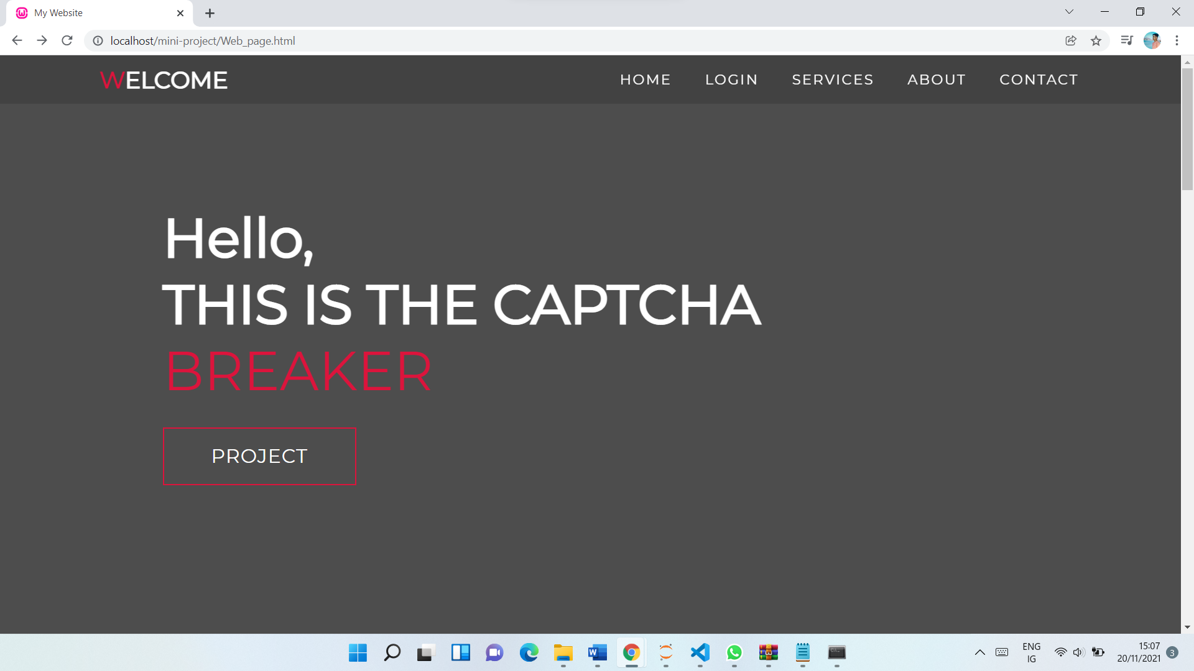
7. Screen shots
Captcha Recognition
Dec - 2021
10

Slide 11
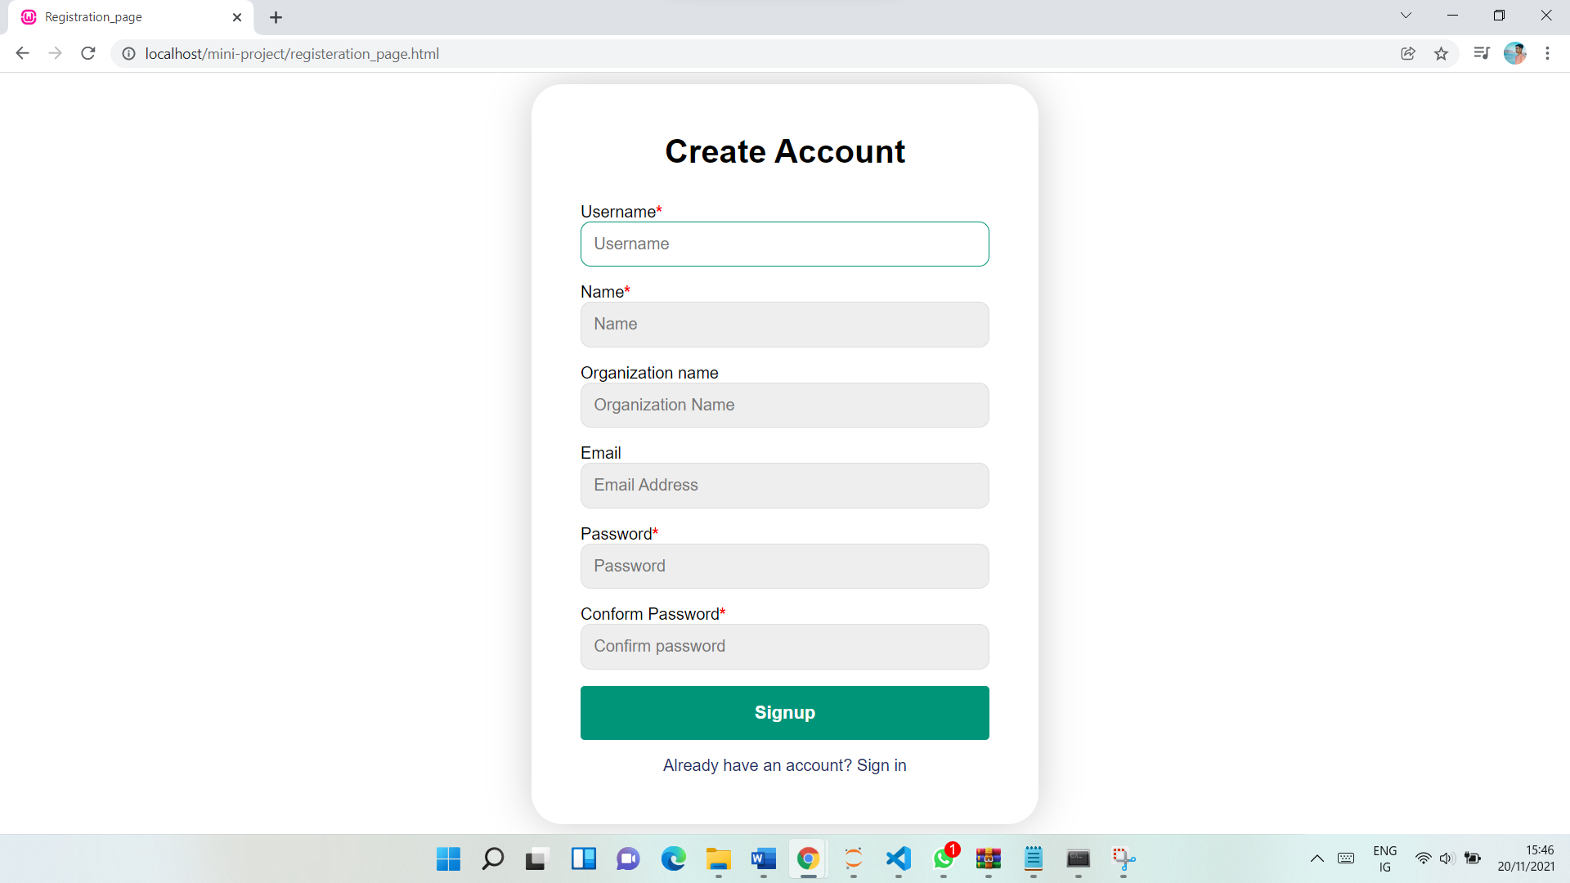
Continue….
Captcha Recognition
Dec - 2021
11

Slide 12
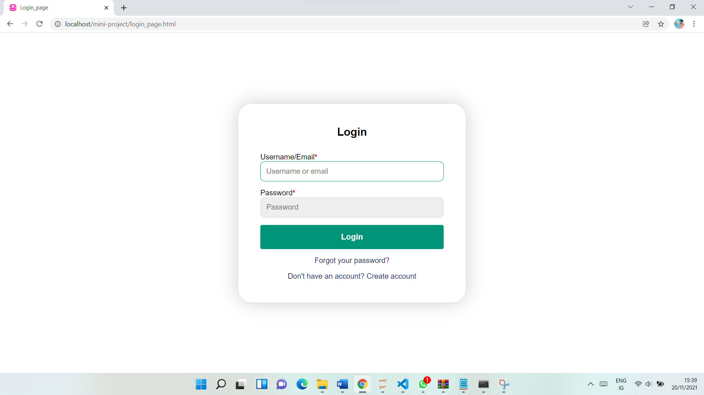
Continue….
Captcha Recognition
Dec - 2021
12

Slide 13
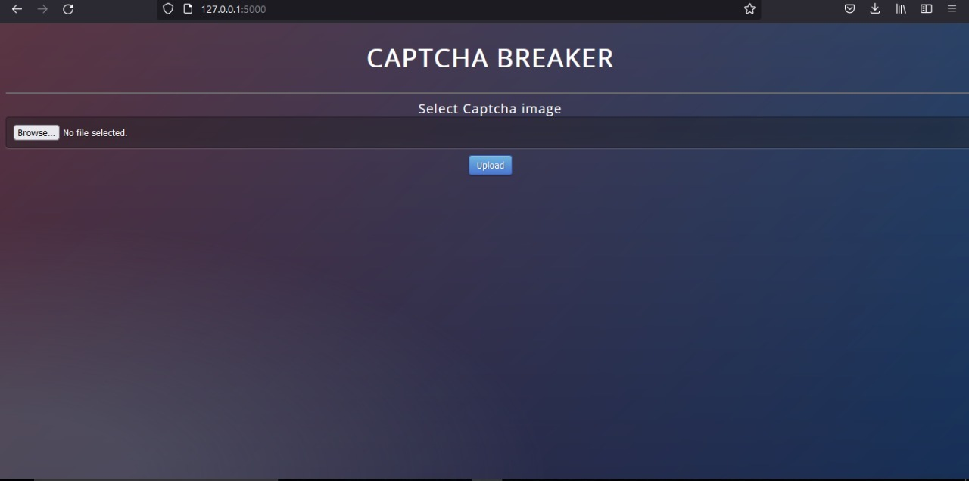
Continue….
Captcha Recognition
Dec - 2021
13

Slide 14
8. Conclusion
CAPTCHA was designed to improve the security of the systems but deep learning algorithms defeated its very purpose. Here, we used Convolutional Neural networks for CAPTCHA recognition. The model has been trained for CAPTCHA containing small English alphabets and digits, thus for a total of 36 characters.
Captcha Recognition
Dec - 2021
14

Slide 15
9. Future scope
The future scope of this work lies to expand this CAPTCHA recognition system for larger and more noisy CAPTCHA containing all the symbols possible.
Captcha Recognition
Dec - 2021
15

Slide 16


